Slide 1
Transition back to school after lockdown: Managing children’s worries

Slide 2
Plan for the session:
Introductions
Hopes and goals for the workshop
Common worries for children when returning to school
What is anxiety?
What can we do to help?
Questions
Notes:
Introduce yourselves and workshop – helping parents notice and manage fears in their children, particularly in relation to returning to school after lockdown
These are the areas that we will cover
Explain that you have muted everyone to manage background noise
If you have any questions we will have time at the end for you to ask them, either by unmuting yourself or posting your question using the chat function
We will have a short feedback questionnaire that will only take a minute to complete and would be grateful if you could complete it afterwards

Slide 3
Common worries for children returning to school after lockdown
No-one will speak to me
I might catch coronavirus
I won’t remember the new rules
What if I bump into someone / touch something?
I might forget and do the wrong thing
I’ll get into trouble if I do something wrong
What if my friends aren’t in the same bubble?
I will miss my mum
What if I don’t like it?
Notes:
Different children will have very different feelings about returning to school, in this talk we will be focusing on children who have some worries about it.
Many worries are understandable in the current context and it’s understandable that some children will be feeling apprehensive about returning to school after being at home with their family for so long.
Read some of the worries out and note that they can be grouped into different areas of concern (catching coronavirus, not remembering rules / doing something wrong in the new school environment, friendship worries, separation anxiety, general worries)
Aim of the slide is to highlight that there is no one universal worry for children and families

Slide 4

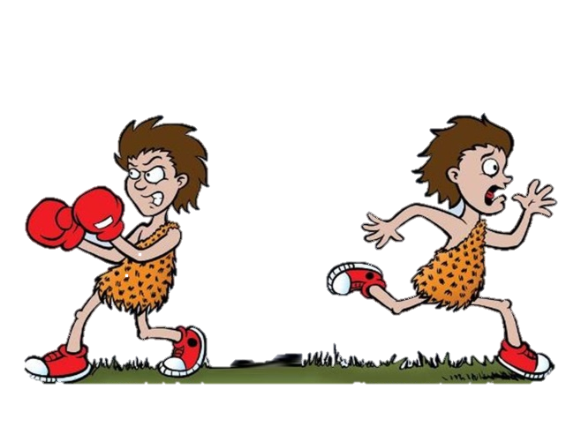
Anxiety
has three characteristics:
Bodily Sensations
Associated with adrenalin - preparing the body for action
E.g. sweating, heart beating faster, trembling
Anxious thoughts
Over-estimate “danger”
Underestimate ability to cope
Anxious behaviour
Avoid worrying situations , so you don’t get the chance to learn if it’s as bad as you think it will be or cope
Seeking reassurance
Fight or flight response
Notes:
Children won’t necessarily tell us outright when they feel worried so adults need to be aware of some of the key things to watch out for as possible signals that children are feeling worried.
Anxiety in children usually comes out in three main ways. We will go through each in turn more throughly later in the presentation but this is just a quick overview to start with.
When we are feeling anxious our bodies respond in a very specific way.
Briefly explain flight or fight.
Children may complain of having a tummy ache, a headache or just say they are generally not feeling well. With heightened sensitivity to coronavirus at the moment it is understandable that parents may be concerned if a child says they are feeling unwell but it is important for adults to hold in mind that these can also be symptoms of anxiety.
Anxious thinking tends to focus on two aspects – focusing on how awful something will be combined with a feeling that you won’t be able to manage it.
Children’s behaviour may change when they are anxious. For any of us, when something feels really difficult or worrying it is natural to want to avoid doing it if possible. Wanting to avoid something you are worried about is understandable but it doesn’t help in the long run. If children are allowed to avoid everything they find difficult then they won’t get the chance to find whether it’s easier to do than they thought or, even if it is difficult, whether they actually can manage those difficulties and come through them.
The other thing that anxious children do is to ask for reassurance and want to check out what is going to happen, what it will look like and get reassurance that it will be ok. Again, it is natural to want reassurance but if we always step in to reassure children then they will always look to adults to tell them what is safe rather than learning over time to make their own judgements.

Slide 5
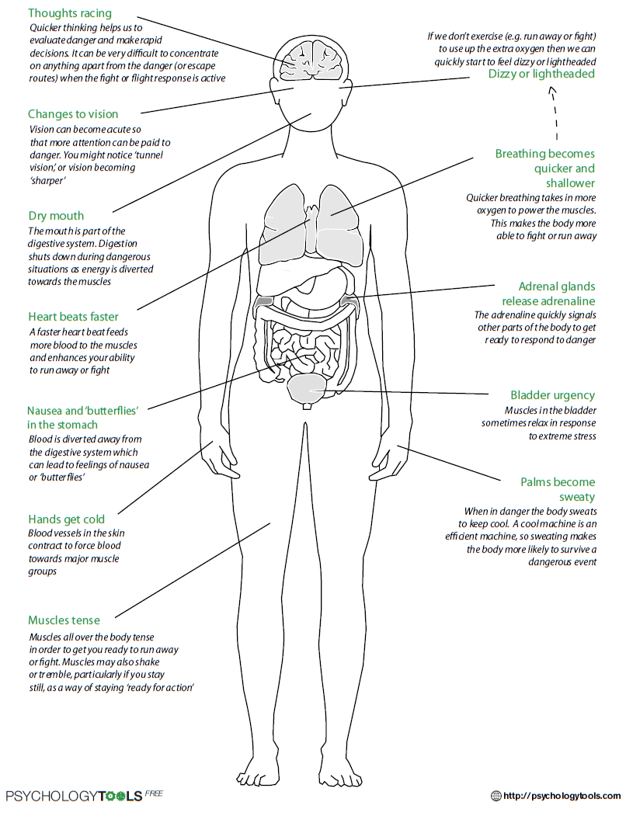
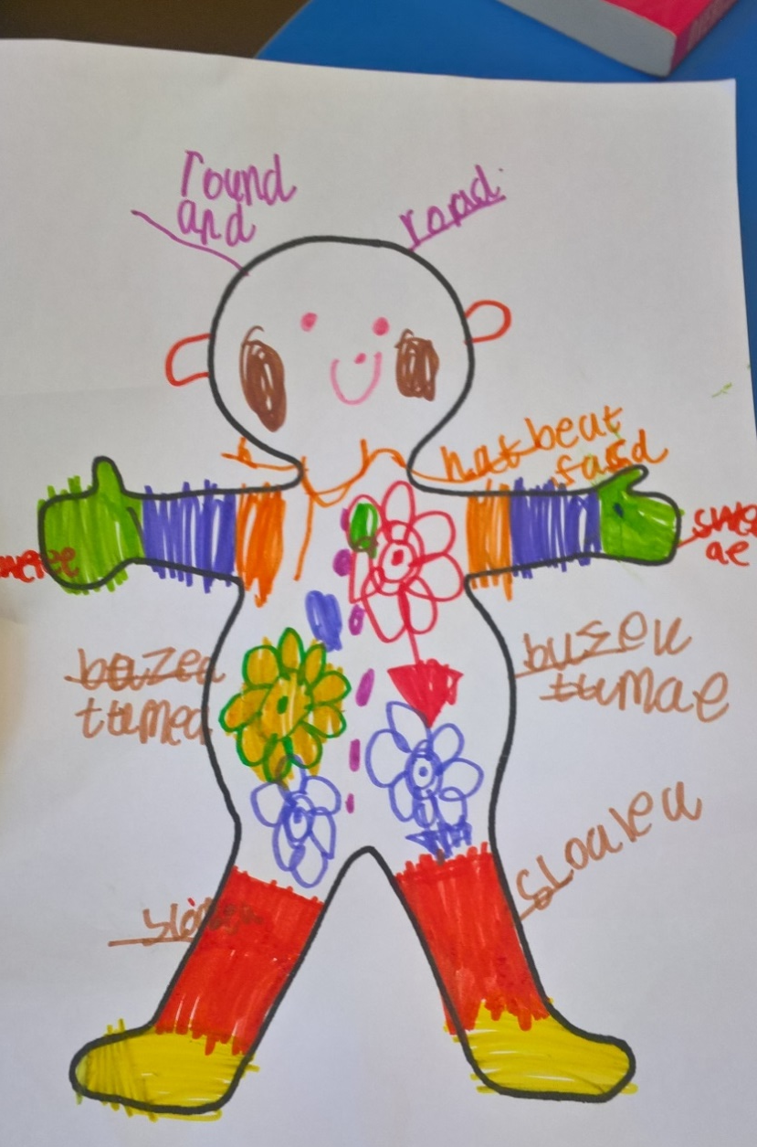
Bodily sensations
Notes:
We’re going to think in a bit more detail about the bodily sensations children often have when anxious and how you can talk to them about it.
As we previously mentioned body sensations are a key characteristic of anxiety. Here are some common ones: heart racing or feeling sick and based on the fight or flight response they happen to prepare you for action.
It is worth thinking about what you notice in your child when they worried? Or yourself?
For an older child you might show them the example on the left with more detail. For younger children, it is helpful to draw a rough body outline and think with them about where they feel worries in their body. This will help to give you a shared understanding with your child about the differences for example between a worry tummy ache and a needing to go to the toilet tummy ache.
Talk through example on the slide – thoughts going round and round in head, feeling of flowers growing in tummy(!), hot legs and feet.
Summarise – understandable that parents are cautious about illness at the moment but really worth not jumping straight into thinking it’s a physical complaint if a child says they are feeling ill. Good to hold in mind that it is the most common way in which worries come out in children, especially younger ones.

Slide 6
Anxious thinking
If someone bumps me I will get coronavirus
The teacher will be cross with me
It will be awful
  Overestimate chance of danger
  Underestimate ability to cope
Anxiety =
I won’t manage
I can’t do it
I won’t be able to talk to anyone
Notes:
Another characteristic is anxious thinking; overestimating how bad something will be and underestimating how well you can cope if it does happen.
Here are some examples of what children may be thinking about coming back to school. When a child (or parent) is catastrophising or jumping to conclusions about all the things that could go wrong and minimising how well they would manage it is understandable that they will feel worried about it.
For most parents, it can feel really difficult to hear your child say things like this. Do try to catch your own thoughts so that you don’t just automatically join in your child’s anxiety.
It is important to try and not treat these thoughts as facts – they are worries, even if there is some reality behind them.
Try asking your child some gentle questions to help them evaluate whether it is likely to be as bad as they fear. e.g. What would be so bad about it?
Can you remember what it was like being in school before lockdown?
Is your teacher usually cross when someone makes a mistake?
Are you normally in trouble at school, why do you think it will be different now?
If you bump into someone who is well and you move away quickly, how likely is it that you will catch coronavirus? Etc
Also help your child to think about what they would do if it did turn out to be difficult. What would their plan be? What would they say to themselves?
Bringing down the fear and raising a child’s sense of being able to cope / having a plan will help to lower their anxiety and feel more confident.

Slide 7
Anxious Behaviour
Ask lots of questions
Outbursts
Clingy or withdrawn
Avoidance
Say difficult statements
Cry
Hit others
Notes:
Children react to anxiety in different ways.
May become withdrawn or more clingy
Ask lots of questions about what will happen to seek reassurance. Watch out for ‘what if….?’ questions
Sometimes behaviour deteriorates – children might shout more or behave badly if they feel overloaded with anxiety. Small things that they can usually manage may make them snap.
These thoughts and feelings can be overwhelming and children often don’t have the language to describe what’s heppening = tantrums
Avoidance- to try and get rid of those feelings quickly.
Useful to think about how anxiety comes out in your child’s behaviour and how you respond to it yourself. Key is to be alert to a change of behaviour in your child – if they are behaving very differently to normal then that would be a warning sign that their emotions or worries might be hard for them to manage.
Summary – easy for parents to become frustrated with poor behaviour and tell children off for being naughty. But if this isn’t how your child usually behaves then try to look beyond the behaviour – try to think about what is going on underneath.

Slide 8
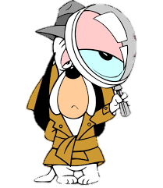
How to find out what my child is worried about?
Explore their worries by asking questions such as:
  “You seem worried, would you like a hug while you tell me about it?”
  “Is there something in particular that is bothering you?”
  “What do you think might happen?”
  “What seems particularly tricky?”
If they find it hard, give your best guess and normalise:
  “Lots of children going back to school might be thinking about….., is that something that you’ve been wondering about too?”
Listen carefully:
  Show your child you care by listening without interrupting
  Don’t rush to jump in with solutions or advice, try to just listen until your child feels you’ve understood
  They may not know why they are worried, that’s also ok
Notes:
Some children, particularly younger children, aren’t able to verbalise what they are scared of or why.
Like most of us, children don’t respond well to being interrogated or nagged to say what’s wrong but it is important to give them some space to talk to you.
Start by just letting your child know you’ve noticed that they seem a bit out of sorts and give them an opportunity to let you know what’s going on “you seem worried, would you like a hug while you tell me about it?”
Follow up with open ended questions but if your child can’t tell you then stop – sometimes children just know that they don’t feel good but don’t even know why themselves.
Normalise by letting them know that lots of children have worries, they are not the only one.
If you have an idea of what’s going in, frame it tentatively and voice it for them “I wonder whether…… might be troubling you a bit”
The most important thing is to listen and give your child some space to speak.
Offer advice or suggestions only once your child feels you have really understood what they are saying.

Slide 9
How can parents help?
* Preparation – 5 key points
* Teaching your child how to relax and distract themselves
*Watching out for your own responses
Notes:
What else can parents do?
We’re going to think about 5 practical things you can do to help your children prepare for going back to school
Helping children have a couple of things they can do to help themselves relax in the moment is useful
Lastly, we know that children watch their parents closely – noting how your own feelings and responses may be feeding into your child’s anxiety is also important.

Slide 10

Preparation
Worry checking
How realistic is the worry?
What is the evidence FOR this worry?
What is the evidence AGAINST the worry?
Then, ask what they would say to a friend who had this worry?
2. How would you cope?
If the thought is realistic, help them think about what they would do to manage?
3. Getting sleep back on track
After a long break from school, sleep routines and structure are important
4. Practising practical steps
Getting up and dressed in uniform
Practise the school walk / commute, see the school from the outside
Make links with the school if you feel you need more information about the new structure or the first days back
5. Stay calm and confident yourself
Children take their cues from adults
Don’t let talk about school or the virus take over everything else
Notes:
This is a bit of a crowded slide but we thought it would be useful to have an overview of what you can be doing to help prepare your children at a very practical level
We have already discussed the importance of checking out children’s worries with them – help them think through about how realistic their worry is and evaluate whether it will really be as difficult as they are thinking it will be.
It is useful to check children’s understanding of what they have learnt by asking them how they would talk to a friend who had a similar worry, it also gives them a chance to practise telling themselves again. What would they say to their friend, how could they help them keep their worry down at a more realistic level.
Note – important to recognise that many worries have some basis in reality. It’s not about taking the worry away, just making it a bit more realistic and manageable.
If their worry comes true, help your child plan for what they would do. How would they cope? Anxiety is fuelled by uncertainty, having some ideas about how they would cope if the worst happened gives children more confidence.
Most children’s sleep routines have been affected by lockdown. Most children are going to bed later than usual and some may be getting up later as a result.
It is much harder to feel calm and manage worries when children are overtired.
Getting back to having a good routine around sleep is really important for helping children feel prepared to return to school
Putting children to bed early rarely works as children won’t fall asleep if they are not tired. Much better to gradually wake them up a bit earlier each day so that they feel tired earlier in the evening. Natural light in the morning also helps reset the bodyclock – good to get children outside in the morning if possible.
To help children get back in the routine, practise getting up at the right time and getting ready for school a few days before they actually return. For very anxious children, you may wish to practise the school walk and go to look at the school from the outside.
Children pick up on parent’s anxiety so consider how you talk about the return to school.
Make sure it isn’t the main topic of conversation, don’t keep coming back to it yourself. Best to talk about it once each day and then answer questions when your children raise it themselves

Slide 11
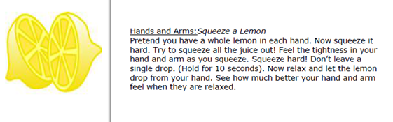
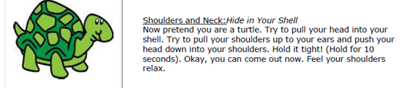
Relaxation
Breathing exercises
Notes:
Explain that these strategies are useful whenever your child is in a heightened state of arousal. Also helpful if children are really excited about something so we are going to talk through and practise some of them.
Best to practise them when children are calm.
Demonstrate both on the video so parents can see.
7 / 11 breathing best for primary aged children.
Concentrating on counting distracts from thoughts and also gives a physiological response in body

Slide 12
Common parent responses to anxiety
Being drawn into giving too much reassurance
Children can become reliant on reassurance and depend on adults saying what’s ok to feel safe
  Ask questions instead: try to help your child work out whether their worry is realistic or not for themselves.
Becoming over protective / colluding with avoidance
Stepping in to protect children from all their fears means they never get the chance to learn they can cope and find out it’s not as scary as they thought
  Instead, notice and praise sensible or brave behaviour
  Encourage them to face their fears in small, manageable steps
Notes:
This slide is just a reminder about how giving reassurance or becoming overly protective can backfire when managing anxiety.
Breaking worries down into smaller steps can be helpful and feel less overwhelming.
Really important to acknowledge and praise brave behaviour or when you hear anything that indicates your child is trying to manage their worries

Slide 13
Managing your own emotions
1. Children are sensitive to how parents feel and take their cues from you
2. Once you have decided your child is returning to school, try to project an air of confidence about it, even if you feel worried yourself
3. Try to remember that your worries are not necessarily your child’s worries, they may not be feeling the same
4. Share with family / friends if you feel you need support with the transition back to school
Notes:
Our children are heavily influenced by how we act and what we do so its helpful for us to monitor our own emotions when supporting them with their worries
Once a decision is made, try not to be wobbly about it yourself. If you can show that you are confident that it will be ok and that your child will manage then they will pick up on that.
You may be more worried about the return to school than your child – important to take a step back and look at how they are really doing, separate from your concerns
It’s important to feel supported so do share concerns with trusted family or friends if you can. Also let the school know if you can so they can be aware that it is a difficult step for you and your child.

Slide 14
QUESTIONS
Notes:
It’s fine not to know the answer or to say that schools would be best placed to answer practical questions about return to school
Give a reminder about the survey feedback – really helpful if they can complete.

